Slide 1
Yard Duty Volunteer Meeting
Morning All Year- 20 Hours
Nutrition All Year- 30 Hours
Lunch ½ Year- 40 Hours
FACTS FAMILY PORTAL
H.umility
A.ccountability
L.eadership
O.ptimism
S.ervice
2023-2024

Slide 2
Yard Duty Team
Mr. Dimitri Spirtos- Oversees daily and weekly audits between Signup Genius and our Raptor Check-in. Please email yardduty@stbonaventureschool.org in advance if you will be absent. Failing to do so will result in a $50 “No Show” Fee.
Mr. Rey Frlekin- Supports SBS as a Yard Duty Attendant
Coach Wolfe serves as PE teacher and Athletic Director and supervises our fields
Coach DeCamp- PE teacher and supervises Walker’s Gate Arrival, blacktop/ bathrooms area, and Junior High Lunch Tables, and Walker’s Gate in the afternoon

Slide 3
Instructional Aides Support
TK- Mrs. Schwab, Mrs. Wilson
Kindergarten- Mrs. Donnegan, Miss Carey
1st Grade- Mrs. Frlekin, Mrs. Vogel
2nd Grade- Mrs. Gonzales, Miss Gabby
3rd- Miss Hatanaka, Miss Wittels
4th- Mrs. Scully, Mrs. Butcher
5th- Miss Silva
6-8th- Mrs. Pai
Instructional Aides provide supervision, clean-up assistance at nutrition and lunch as well as continue to supervise students at play.
If an Instructional Aide asks you to do something such as clean up or supervise a group of students please follow their instructions.

Slide 4
Family Yard Duty Volunteer
Yellow Vest
Walkie Talkie…Channel 2, Volume Turned Up
Raptor Name Badge printed each day you serve
No Cell Phones, No Air Pods, No taking pictures of students,
No lengthy conversations with other adults, No drama
Don’t be passive, hold students accountable for safe and kind choices and words.
Be helpful in cleaning up the lunch table areas and supervising students
There are a lot of other areas to volunteer in if you don’t feel comfortable.
Student safety at recess and setting students up for successful play is our top priority!

Slide 5
STUDENT PLAYGROUND and PLAY EQUIPMENT RULES
Recess is an Opportunity for: Social skills development, physical outlet to move energy, fresh air, Vitamin D, Strengthening Friendships, fine and gross motor development etc.
Recess is not an Opportunity for: Super competitive play, arguing, play fighting etc.
No food is to be eaten in the play areas (Courts, Blacktop, Fields, Play Structure)
Chase and tag games are not permitted on blacktop areas as these games could cause students to trip or accidentally shove one another.
No Grabbing and Capture, pretend fighting and shooting games
Equipment must be used for its intended purpose (ie volleyball, jump rope etc.)
Volunteers should pick up and/or report rocks, debris or other items that are or could be unsafe to the students
Students should not be playing on the Handicap ramp or railings
Students are not allowed access to their classroom areas during recess time
Restrooms are not areas of play and we will need to have Volunteers stationed at the bathroom area supervising the students volume level and traffic flow.
Please radio yard duty, Coach Wolfe/DeCamp if a child need to visit the Health Room, DO NOT use students Names over the Walkie Talkies.

Slide 6
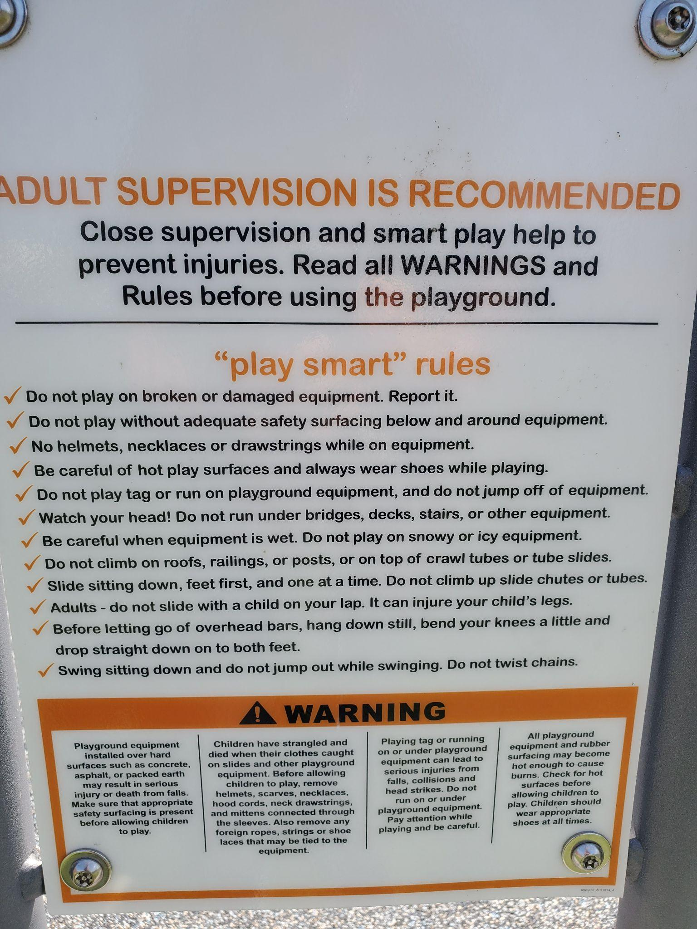
Play Structure Expectations
Make good decisions! Show respect! Be a Problem Solver! Have fun!
ONE PERSON AT A TIME bridges,slides,climbing wall,ladders,spinner
Help keep balls and other other equipment out of the playground area
No climbing up the slides, or sitting at the bottom of the slide area
No running, chasing or tag games in playground area
“Slow is Smooth, Smooth is Fast”
ONE direction for bridges, slides, climbing wall, ladders, monkey bars
SPINNER: must be “inside” with feet on the green -10 spins per turn, NO spinning friends
MONKEY BARS: DO NOT pick other students up to help them reach
ROCKWALL: wait until the person before you has made it all the way up before going

Slide 7
PLEASE READ AND REVIEW THE FOLLOWING
Cell Phone Use and Earbuds
“I have to take this work call.”
Walkie Talkies
Volume should be turned up, and left turned up.
Hold the green button to speak “I need Help at … location”
Student safety is our top priority. If you are afraid to say something you are putting our students and school at risk.
The BELL/WHISTLE
Mr. Spirtos will give a 2 minute warning over the Walkie Talkie, please tell the students in your area they have 2 minutes.
The Bell/Whistle means play needs to stop and it is time for students to use the bathroom, wash hands, and line up, not take one more shot or squeeze in a final play.
The Whistle does not mean you are done supervising and keeping students safe
Incident Report
If you are a witness to a physical altercation or an accident please request a “Witness Statement” to fill out.
It is the school’s role to make contact with the students’ parents regarding any incidents that occur.
Do not take pictures of students at play
What do I do when I see my child/ grandchild
Be proactive on the ride to school
Give them some love when you see them, but encourage them to move on and play with their friends
Continue to support and get to know the other children you are responsible for
“Hovering Parents Can Lead to Anxious Kids” Article

Slide 8
MOBILE: Supervisors should not be seated or standing stationary. Instead, you should be actively moving around the playground area students. To correct and encourage proper play and language. Stay on the perimeter, but move in when necessary to correct behavior etc.
OBSERVANT: Supervisors not only need to stay tuned into student behavior and actions but also need to be listening to students’ dialogue and ensuring that verbal communication is appropriate between students.
VISIBLE: Supervisors should wear their colored vests and be visible and easy to locate for parents, teachers, and students in need.
ENGAGED: Talk to students, but find the balance so that you are not taking your attention away from other students.
SEE SOMETHING, SAY SOMETHING, DO SOMETHING

Slide 9
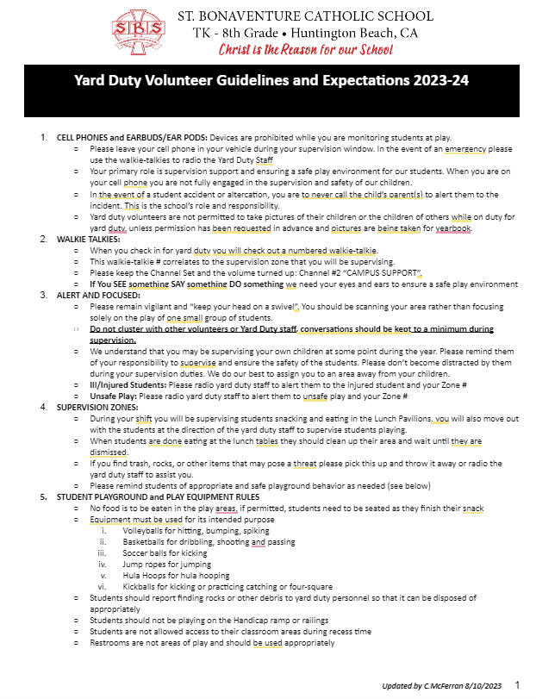
Make sure to review and sign prior to serving
Yard Duty Volunteer Guidelines and Expectations 2023-24

Slide 10
THANK YOU!
Morning All Year- 20 Hours
Nutrition All Year- 30 Hours
Lunch ½ Year- 40 Hours
FACTS FAMILY PORTAL

